Slide 1
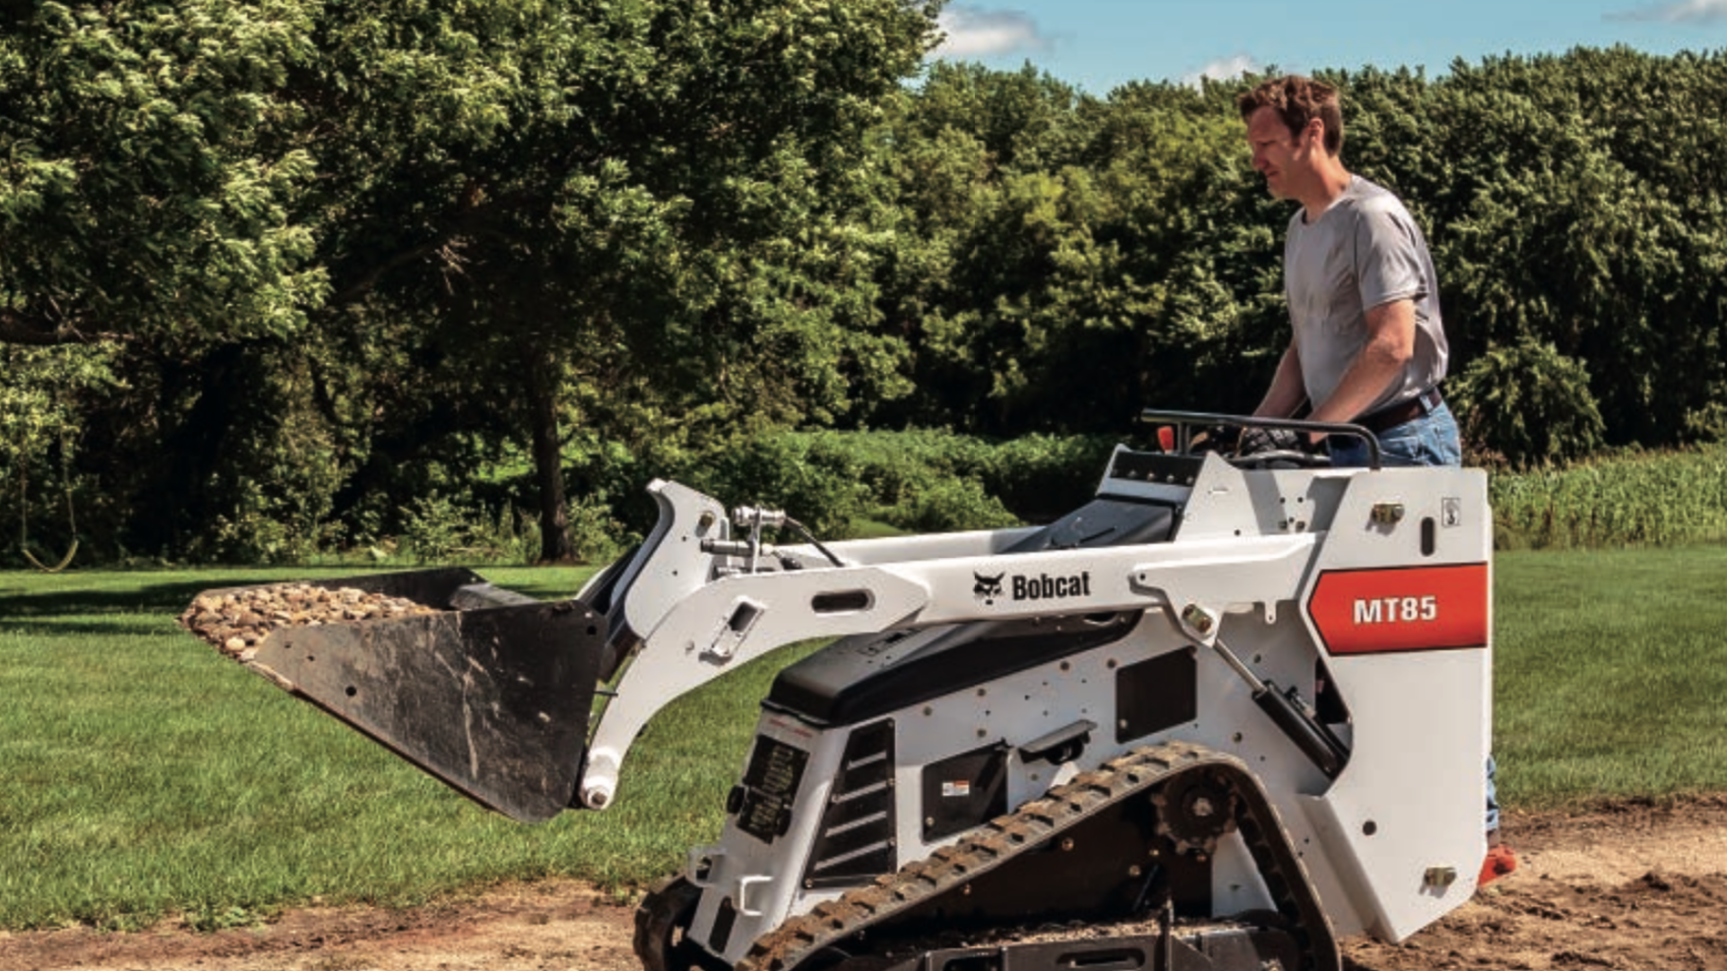


Bobcat MT85 Customer Needs Research

Slide 2
What were we trying to find with this research?
We were trying to find the most important needs that current Bobcat MT85 owners and potential customers are looking for when making a decision on which Mini Track Loader they would like to purchase.

Slide 3
How did we conduct the research?
First, an in-person in-depth interview took place with an owner of a Bobcat MT85 Mini Track Loader.
The interview took approximately 36 minutes to conduct.
The owner purchased the Bobcat MT85 brand new from a KC Bobcat dealer in the Kansas City, MO area.
He had owned it for around 7 months at the time of the interview (he wasn’t sure if he purchased it 6 or 8 months prior).

Slide 4
How did we conduct the research?
The interviewer discussed the following topics with the owner of the Bobcat MT85:
Purchase decision / criteria for selection
Product use and application
Most important product features / benefits
Other brands / products considered
Satisfaction with current product / surprises from use
Maintenance / Parts / Overall experience
Next purchase / considerations
Anything else not mentioned

Slide 5
How did we conduct the research?
Once the interview was complete, a transcript was made of it and a research analyst read through it and extracted the needs that the Bobcat MT85 owner had expressed throughout the interview.
There were 41 total needs found by the research analyst but they were narrowed down to 10 in order to conduct a MaxDiff survey to other potential buyers of Mini Track Loaders using the online survey program Sawtooth.
The needs that were used for the MaxDiff survey were a summary of the most important things that the owner liked about the Bobcat MT85 as well as things he thought could be improved on it.

Slide 6
What needs were used for the MaxDiff Survey?

Slide 7
The needs that were used on the MaxDiff Survey:
Lifting Capacity
Turn Radius
Leg Padding
Operator Controls
2-Speed Transmission
Length of Warranty
Size of fuel tank
Size of hydraulic pumps
Options for Attachments
Ground Clearance
What needs were used for the MaxDiff Survey?

Slide 8
What is a MaxDiff Survey?

Slide 9
What is a MaxDiff Survey?
A MaxDiff Survey is a survey designed for obtaining preference/importance scores for multiple items.
MaxDiff is also known as "best-worst scaling.”

Slide 10
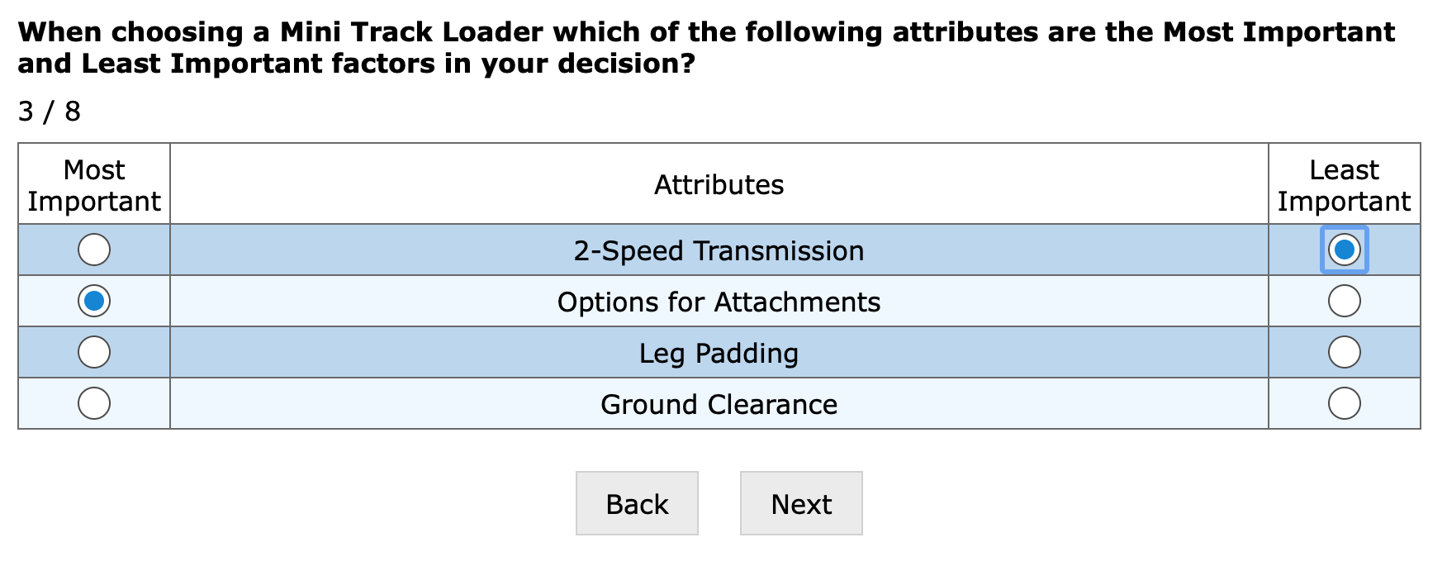
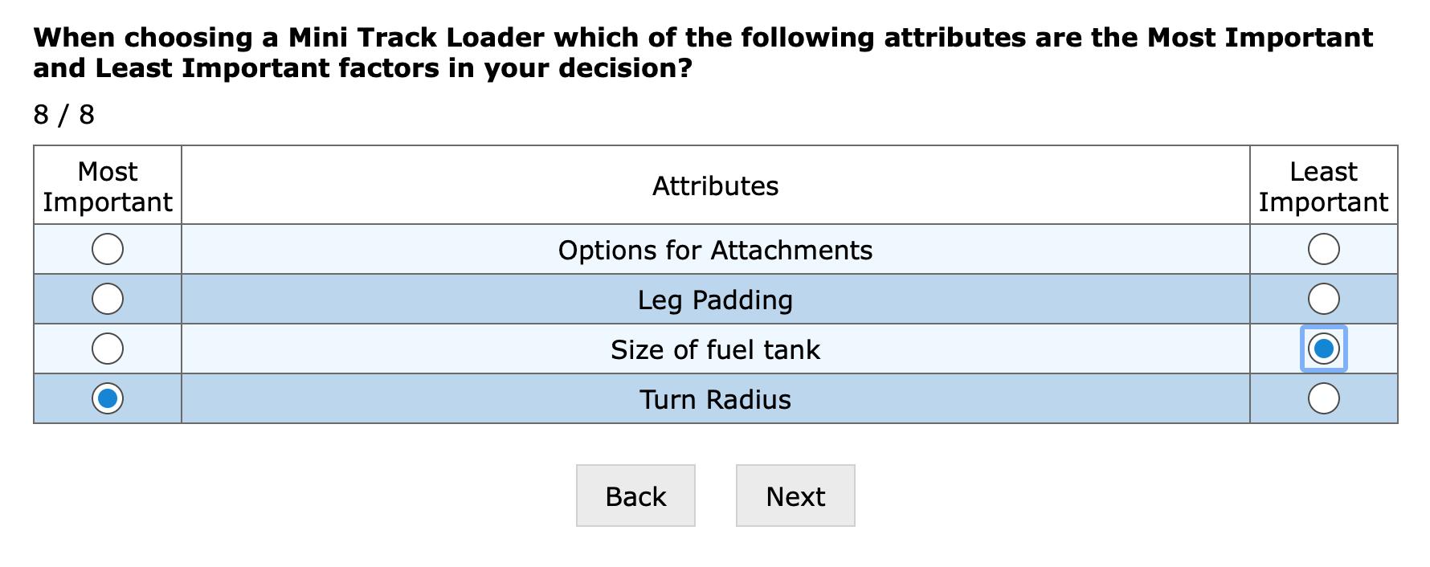
Questions from our MaxDiff Survey

Slide 11
Results from our MaxDiff Survey

Slide 12
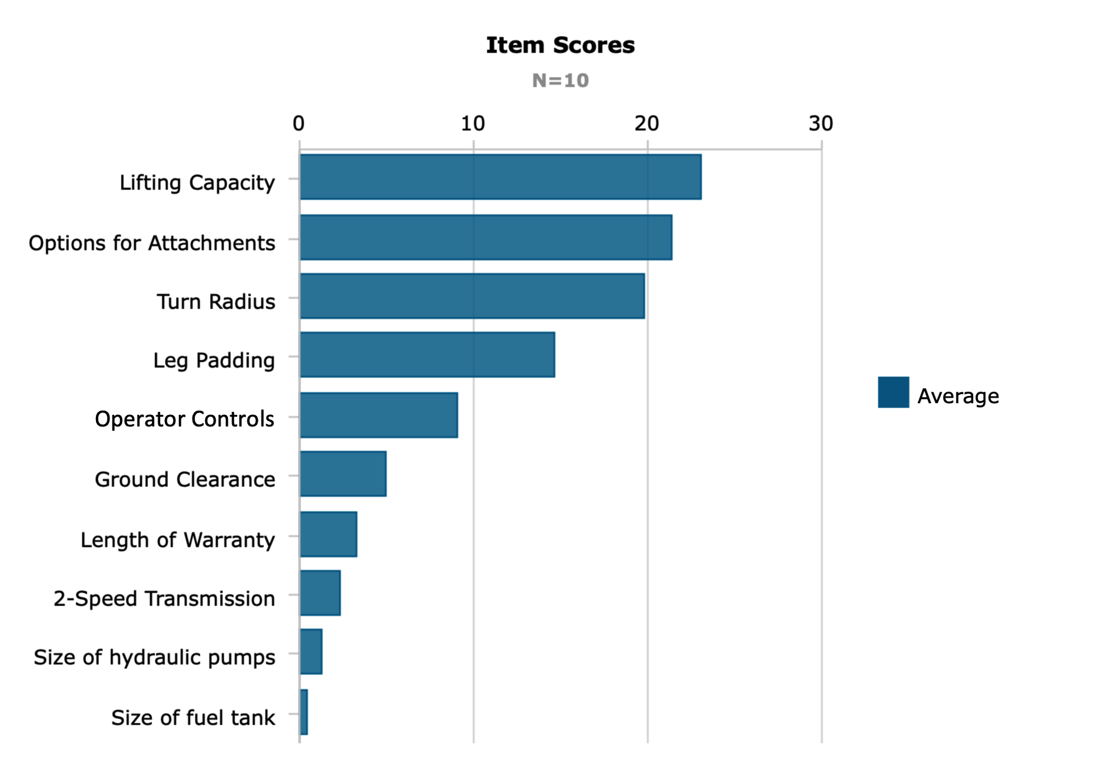
Results from our MaxDiff Survey
The most important attributes were:
Lifting Capacity
Options for Attachments
Turn Radius
Leg Padding
Operator Controls
Note: “N=10” means there were 10 completed surveys

Slide 13
Insights from the MaxDiff Results
According to the owner that was interviewed, the Bobcat MT85 already does a great job of 3 of the top 5 attributes that were most important to the survey participants (Options for Attachments, Turn Radius, & Operator Controls).
The 2 attributes from the top 5 however that the owner was not positive about were the Lifting Capacity and the comfort of the Leg Padding.

Slide 14
Insights from the MaxDiff Results
The Bobcat MT85 owner had this to say about the lifting capacity:
“it wouldn't hurt to have a little more (lifting capacity) because I think it could handle it.“
He did however find the balance of the MT85 as a positive attribute, stating:
“I think the balance on this one's way better than that, the handling. The machine's balanced a lot better. The lifting .. I just think when you pick a load with it or you got a pile in the dirt, it doesn't feel like it's all front heavy. It feels like the machine's on pretty solidly”

Slide 15
Insights from the MaxDiff Results
The Bobcat MT85 owner had this to say about the leg padding on it:
“When you first run this thing, it beats your freaking legs up because you're not used to it and you're not used to standing up on something. It freaking annihilates your legs until you get used to it.“
Also, the Bobcat MT85 owner’s coworker that was with him during the interview said that he “got bruises all over his hips” from using the MT85.

Slide 16
Insights from the MaxDiff Results
The Bobcat MT85 owner had this to say about the options for attachments:
“I think Bobcat's probably got a little bit of pro in regards to just the features and the attachments and the service side of it.“
As far as the turning radius, he stated:
“In a tight spot it's freaking awesome. When we're working around tight shit all the time, you don't have worry about banging the back end of the machine around and everything like that.”
His thoughts on the operator controls:
“(Interviewer) What do you think of the controls? (Owner) I think they're perfect the way they're set up.”

Slide 17
Other Insights from the Interview
The Bobcat MT85 owner also had these issues with the MT85 that were not included in the MaxDiff Survey:
“The track's wanting to sprawl out a little bit on the wide-track version.”
“I had some problems with it when we first got it. There was a linkages coming apart on the hydros and all that stuff… The throttle cable came loose on me and then two of the controls on the hydro-stat pump, the arms that work that whole system.”
”The three cylinder motor kind of worries me a little bit just because it shakes so much.”
“They (the hydraulic pumps) get to squelching pretty good if you work it pretty damn hard.”
“The phone holder could be a little bit bigger.”

Slide 18
Summary of the Insights
Continue with the current system for the tight turn radius, balance, options for attachments, operator controls, and length of warranty.
Improve the comfort of the leg padding on the MT85.
Look into increasing the lifting capacity of the MT85 if possible.

Slide 19
Does anyone have any questions or comments?

Slide 20
Thank You!

